Slide 1
Analysis of PBMC Gene Expression Data in Asthmatic Patients
Kieran Ford, Richard Garber, Jonathan Kahn (Team 12)
Notes:
Slide template from slidesgo: https://slidesgo.com/theme/science-subject-for-middle-school-6th-grade-biology#search-biology&position-3&results-114&rs=search

Slide 2
01
INTRODUCTION
Asthma is Variable
Immune Response Link
T-Cells
Severity and onset varies from person to person
Previous study ID’d certain immune responses to fungus as having an association with asthma severity
Previous study ID’d possible relationship to inflammation in pathways with helper T cells, a type of lymphocyte
Notes:
https://pubmed.ncbi.nlm.nih.gov/33773471/ & https://pubmed.ncbi.nlm.nih.gov/27189668/ & https://www.nature.com/articles/s41598-022-12199-0 & https://www.nature.com/articles/s41588-018-0121-0

Slide 3
01
INTRODUCTION
Previous GWAS Studies…
Support for Link?
Identified genes and loci of interest relating to immune system
Can we support previous findings of a link between the immune system and asthma?
Notes:
https://pubmed.ncbi.nlm.nih.gov/33773471/ & https://pubmed.ncbi.nlm.nih.gov/27189668/ & https://www.nature.com/articles/s41598-022-12199-0 & https://www.nature.com/articles/s41588-018-0121-0

Slide 4
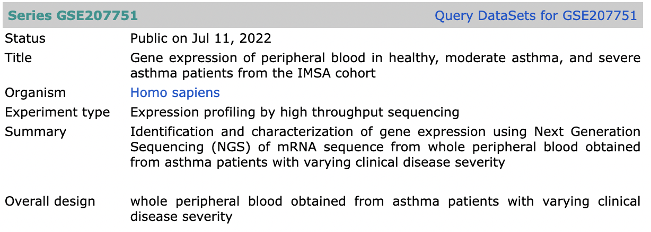
01
INTRODUCTION
Our Data:
- NGS
- GEO Database (GSE207751)
- 56 samples
- 42 asthma patients with
varying severity
- 14 patients without
asthma
Metadata:
- Age
- Gender
- Level of severity
Notes:
https://www.ncbi.nlm.nih.gov/geo/query/acc.cgi?acc=GSE207751

Slide 5
02
HYPOTHESIS
What are the differences in gene expression within peripheral blood mononuclear cells between patients with moderate or severe asthma and healthy patients?
Why PBMCs?
Peripheral Blood Mononuclear Cells
Contain Lymphocytes (T-Cells)
Why these groups?
Ignoring severity would allow us to make generalizations to asthma patients in general versus a subset based on severity
Notes:
https://www.ncbi.nlm.nih.gov/pmc/articles/PMC4673925/

Slide 6
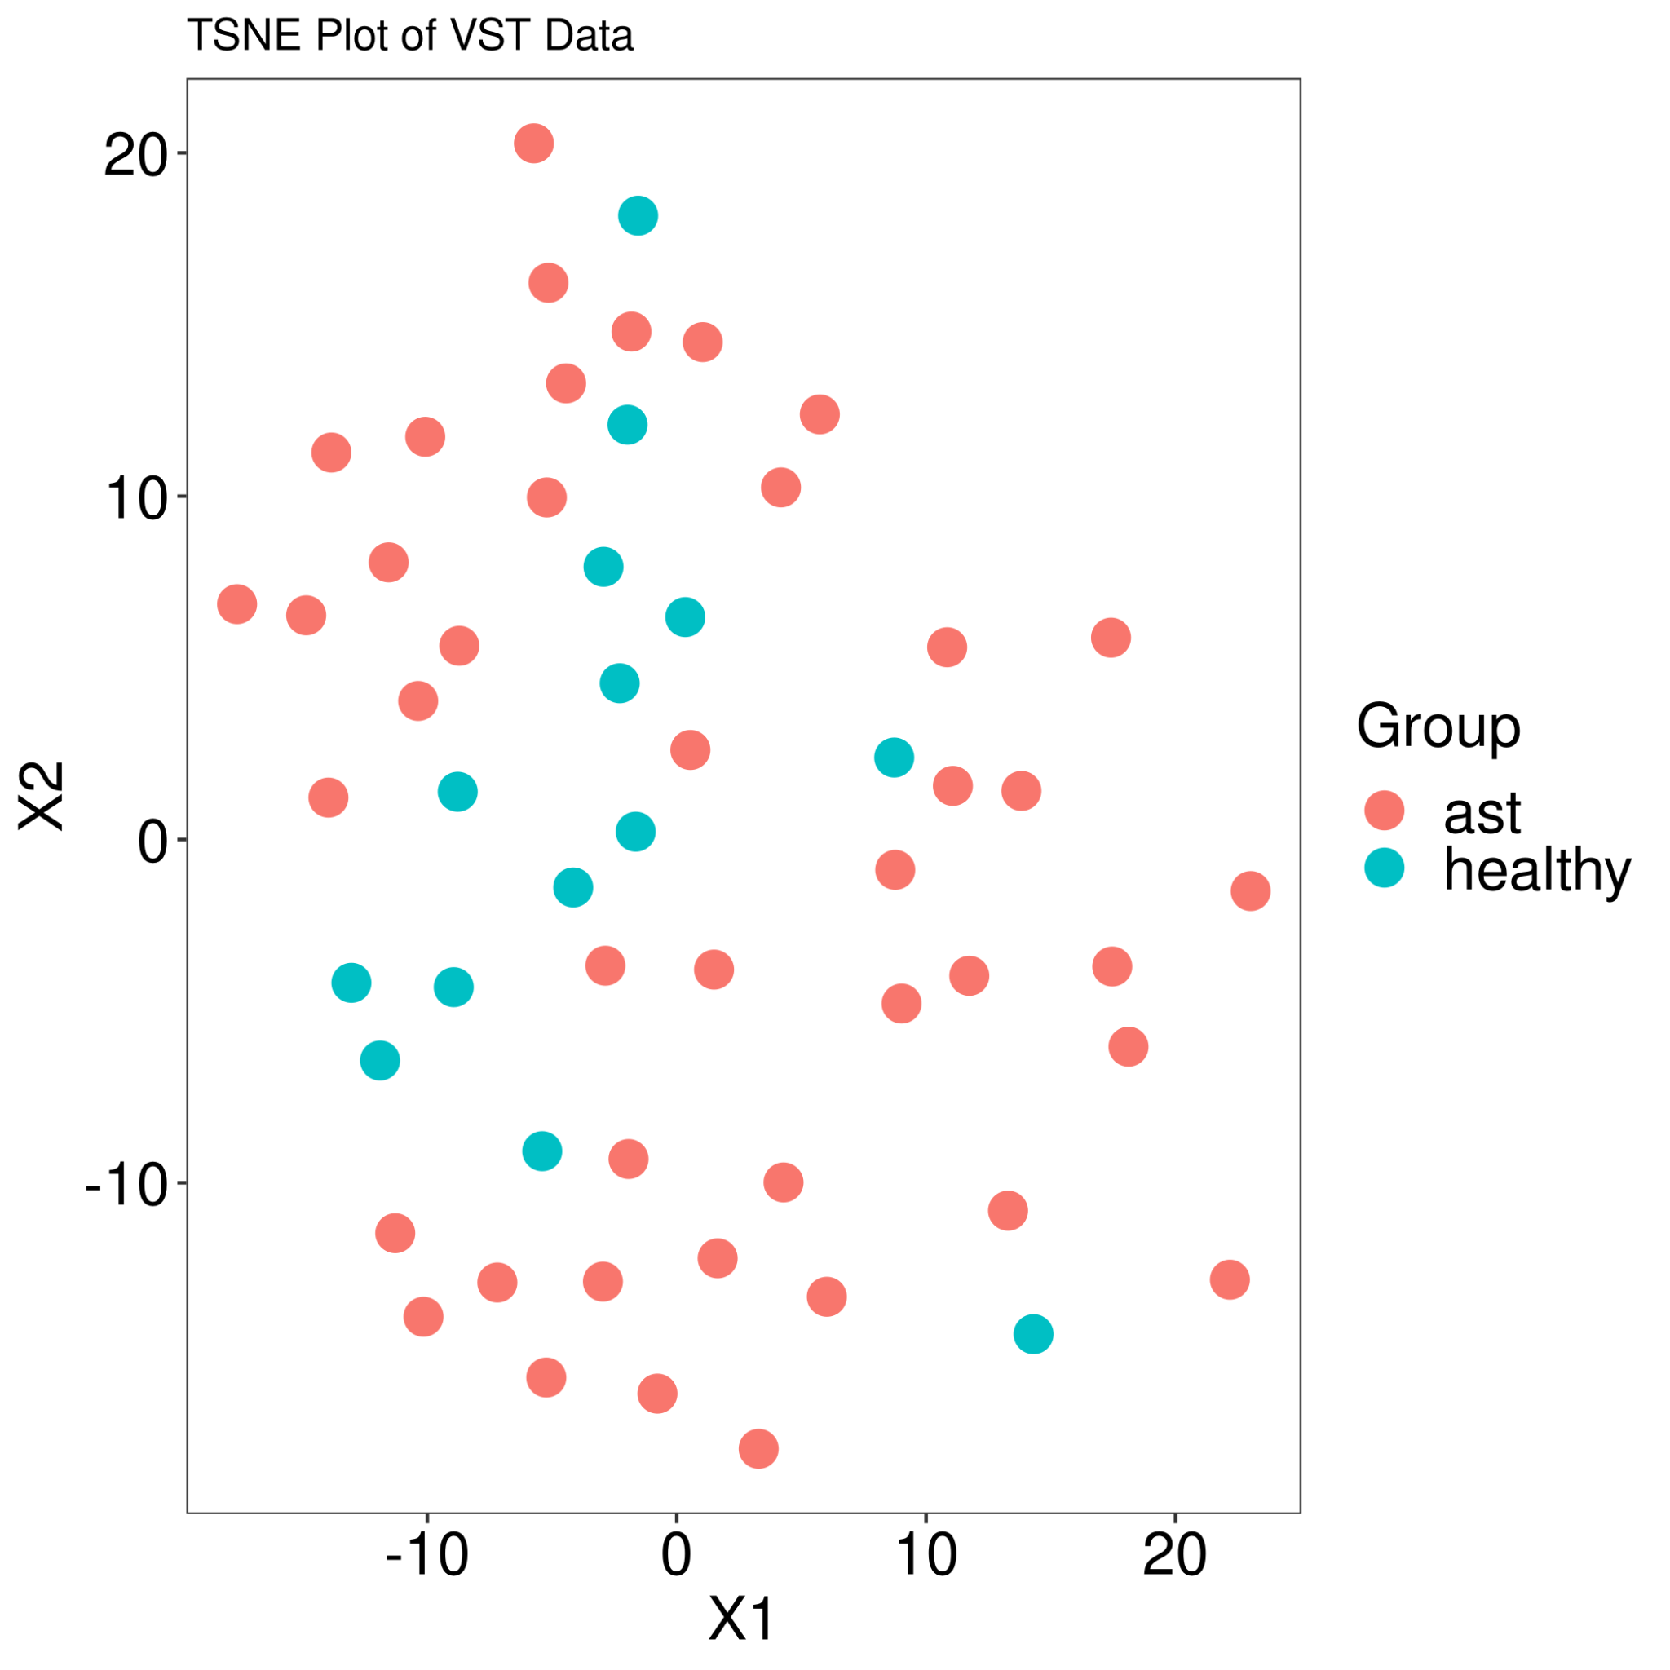
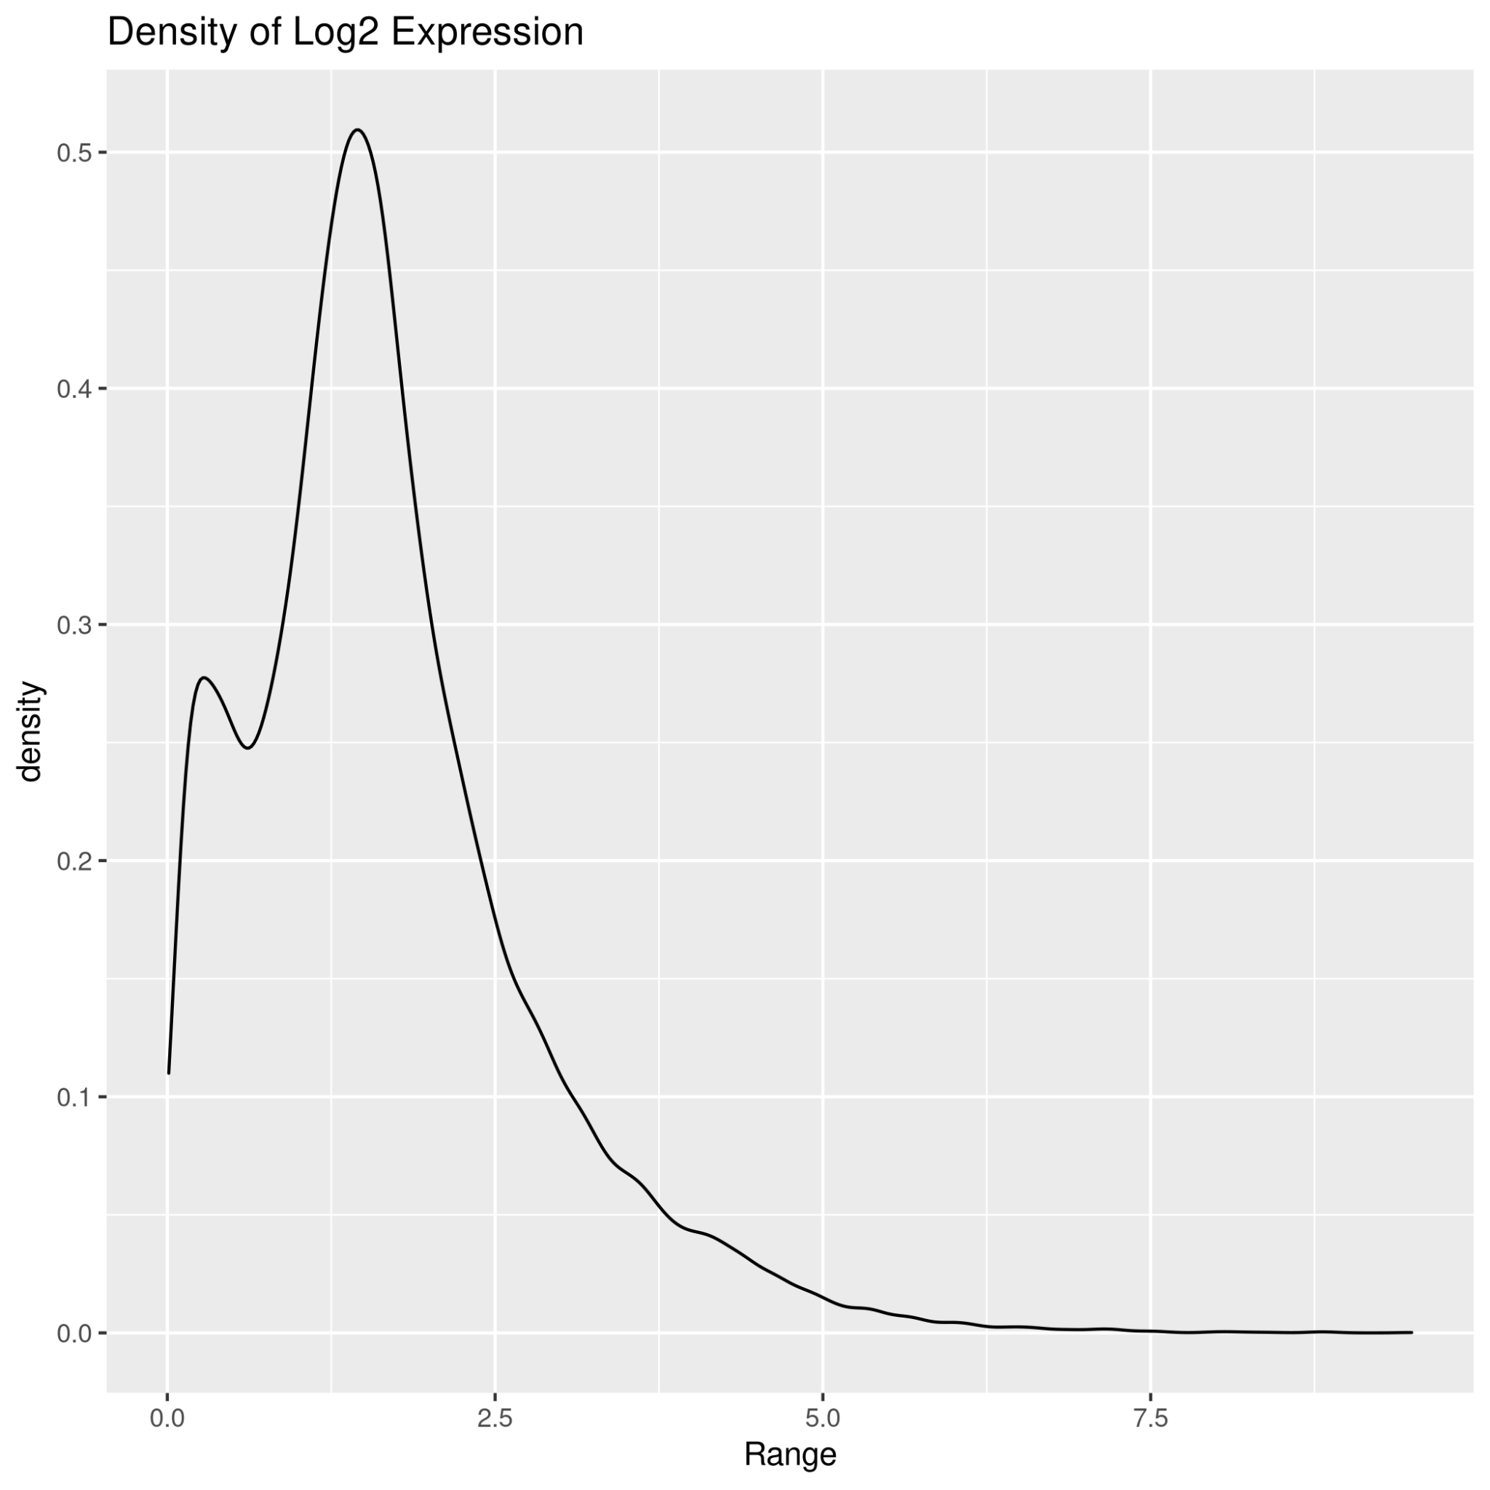
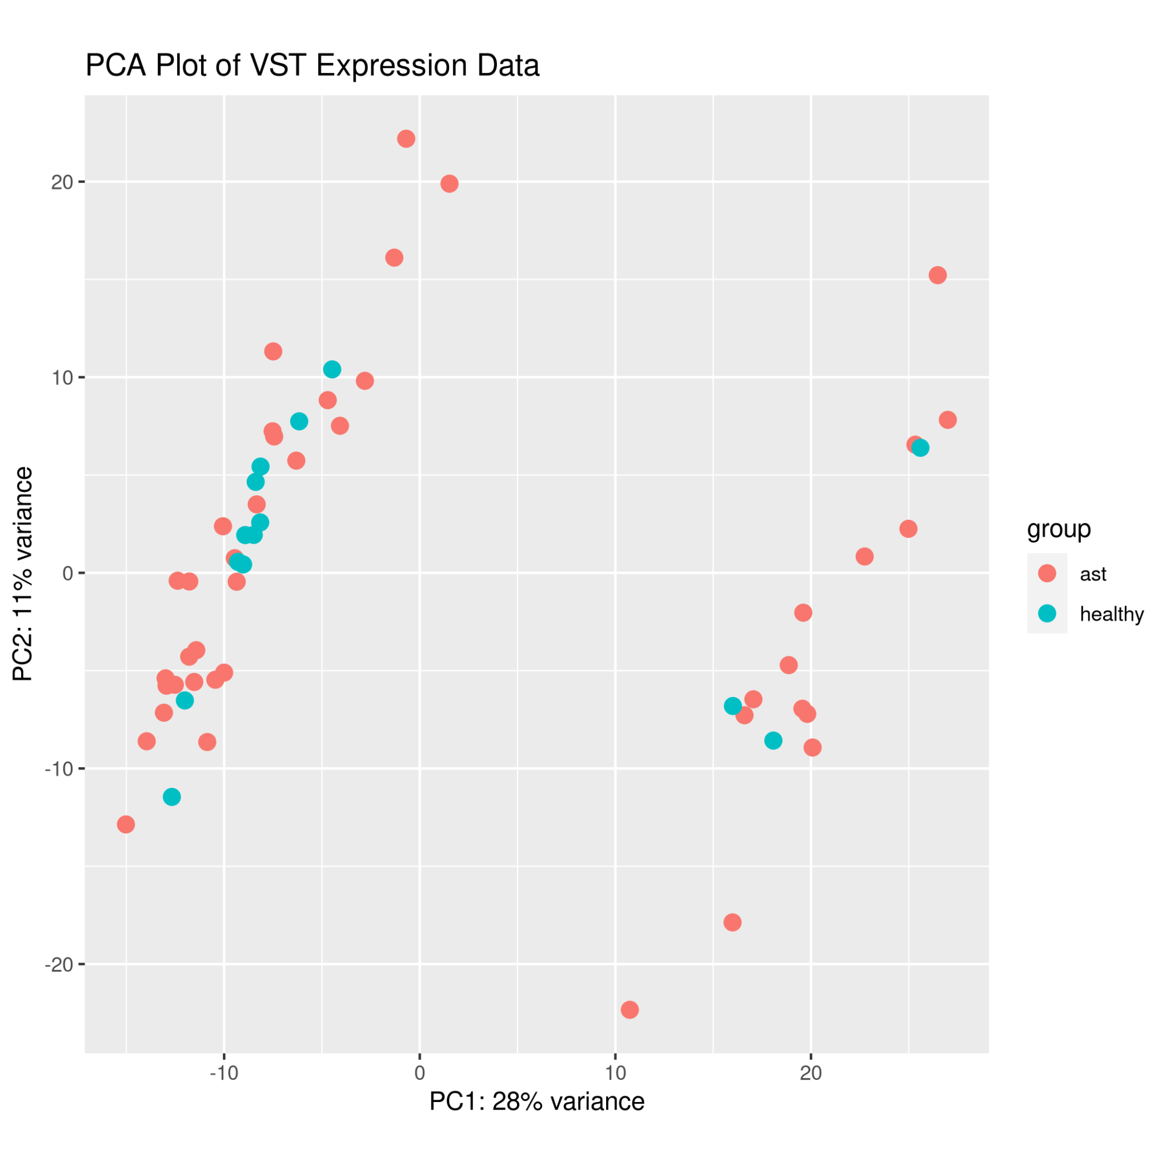
03
DIFFERENTIAL EXPRESSION
Density shows data does not have wide range of expression
Tail suggests some genes do have wide range of expression
PCA shows clustering but not by condition group…suggests little correlation
t-SNE shows no clustering…suggests little correlation

Slide 7
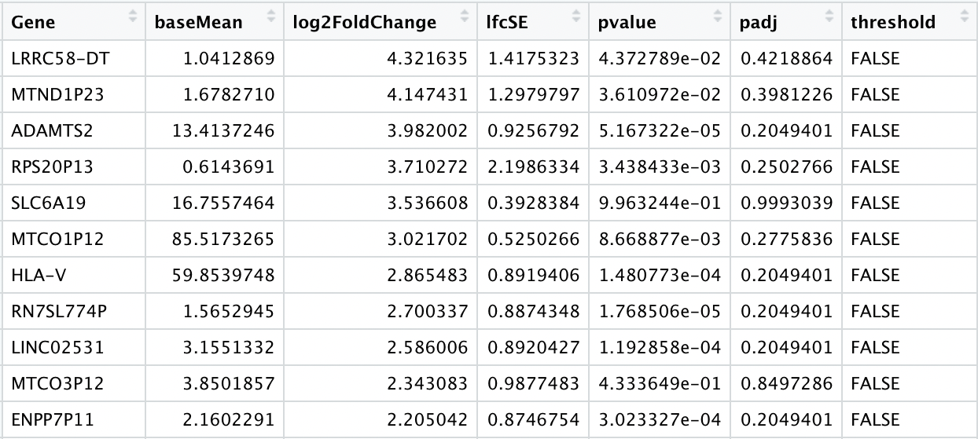
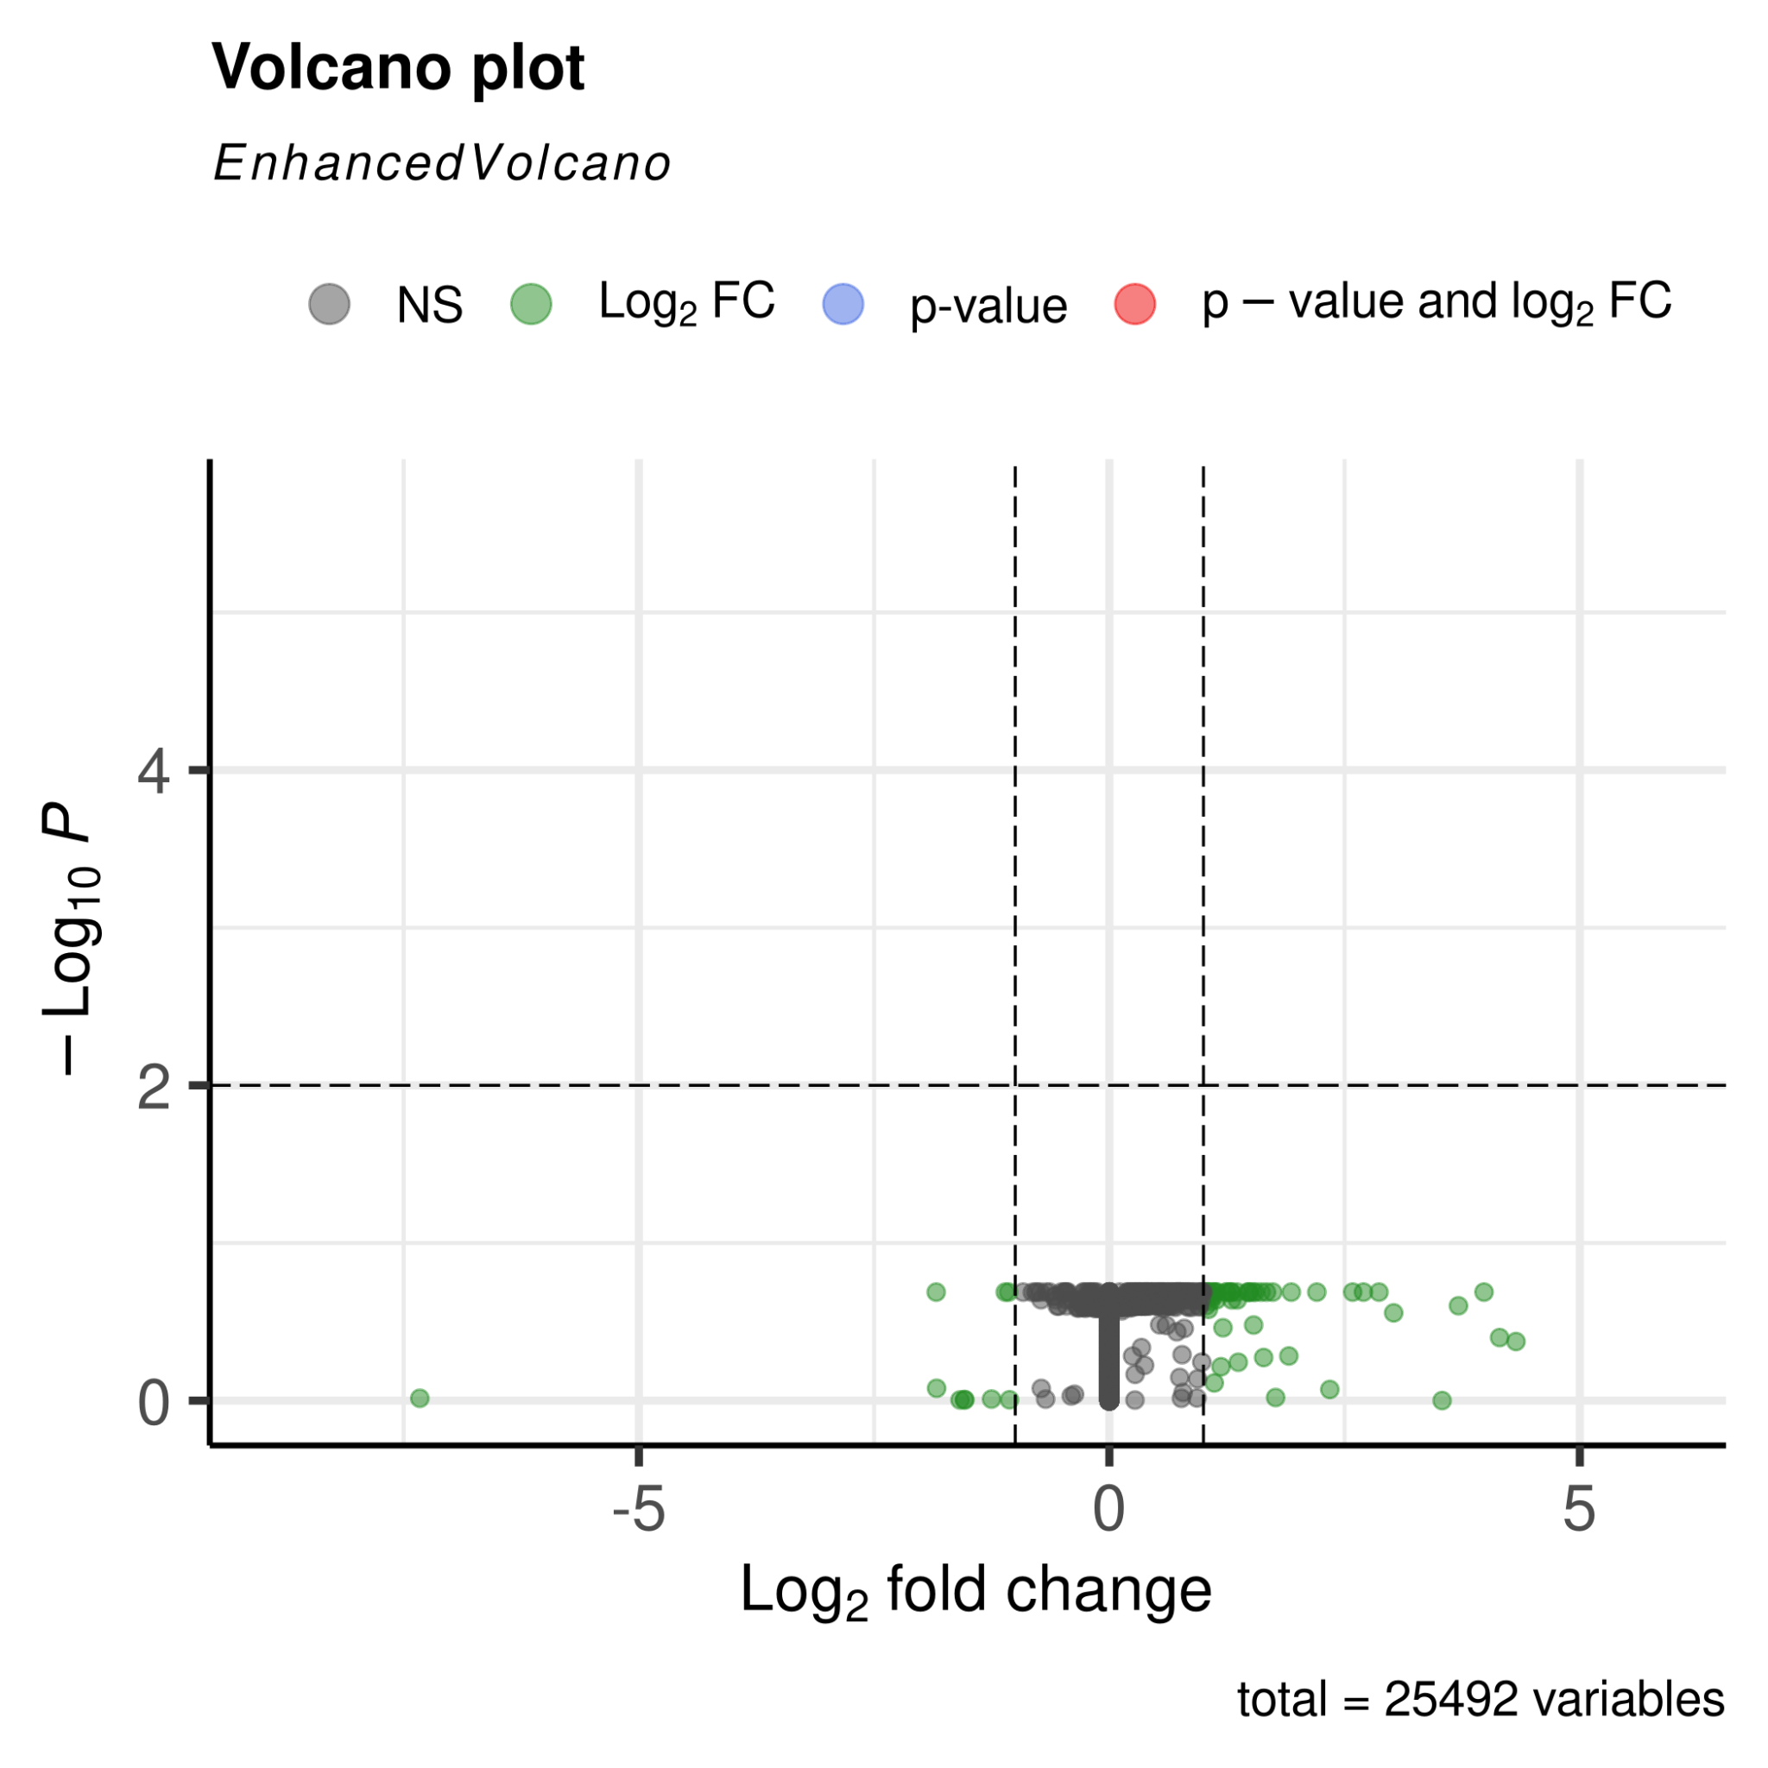
03
DIFFERENTIAL EXPRESSION
DESeq2
No significant values
However…65 genes of interest based on LFC
*Not Significant* but *Differentially Expressed*
Will use these 65 genes for enrichment analysis

Slide 8
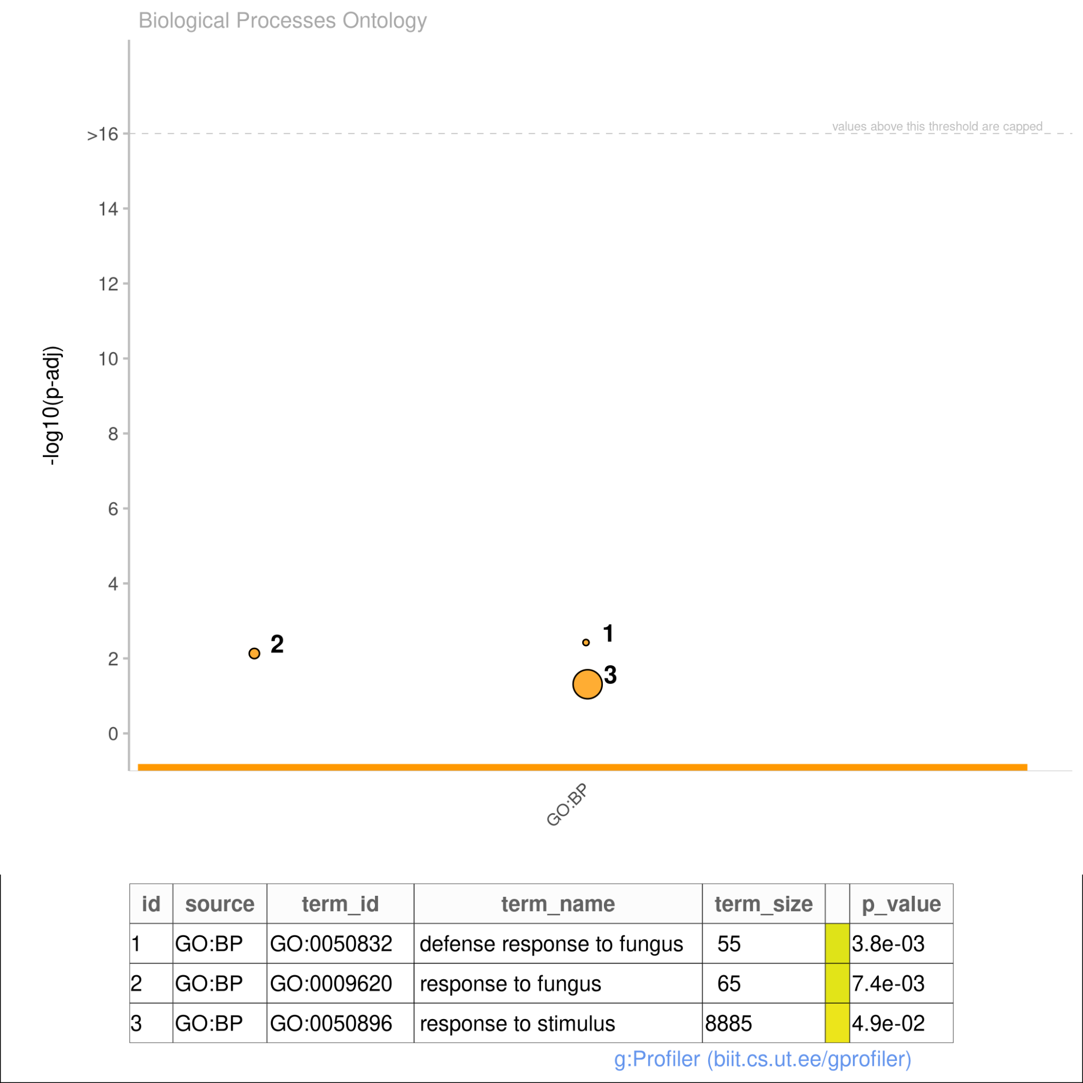
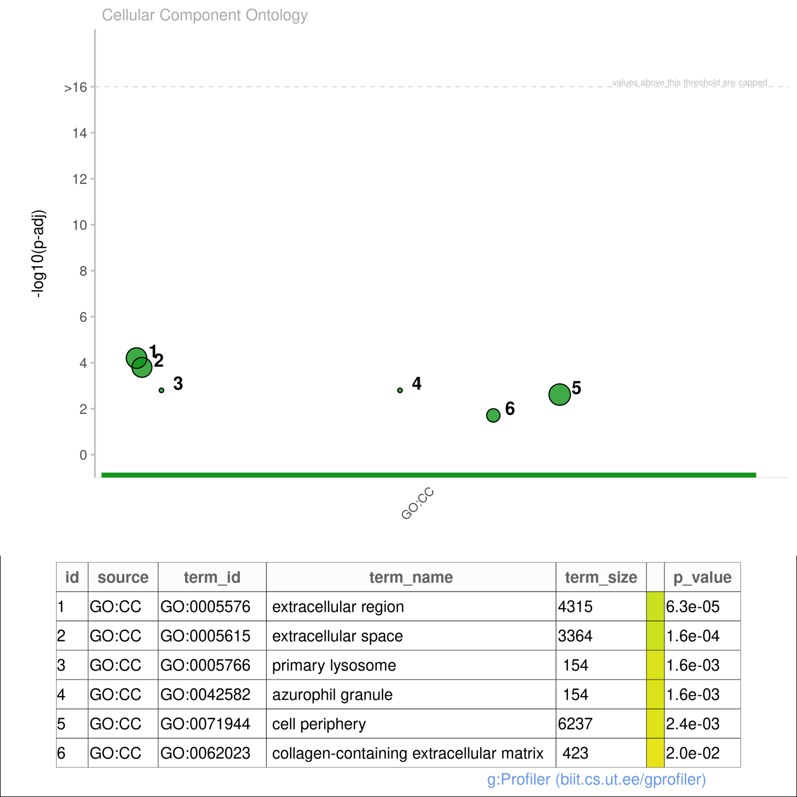
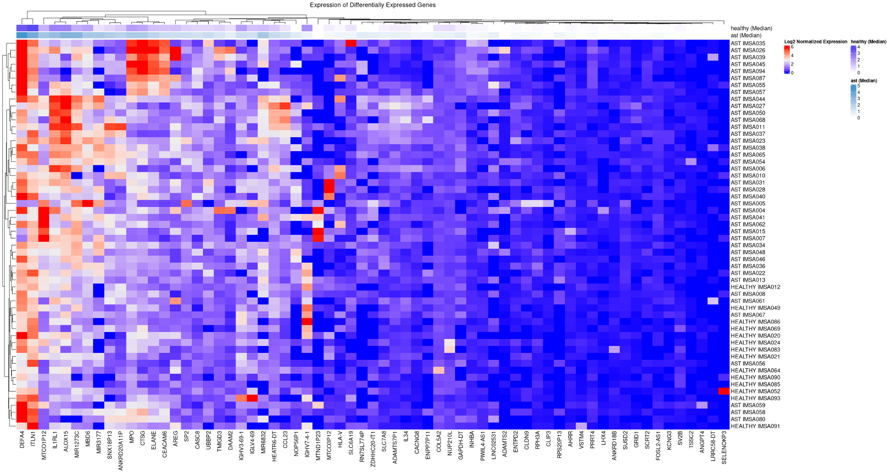
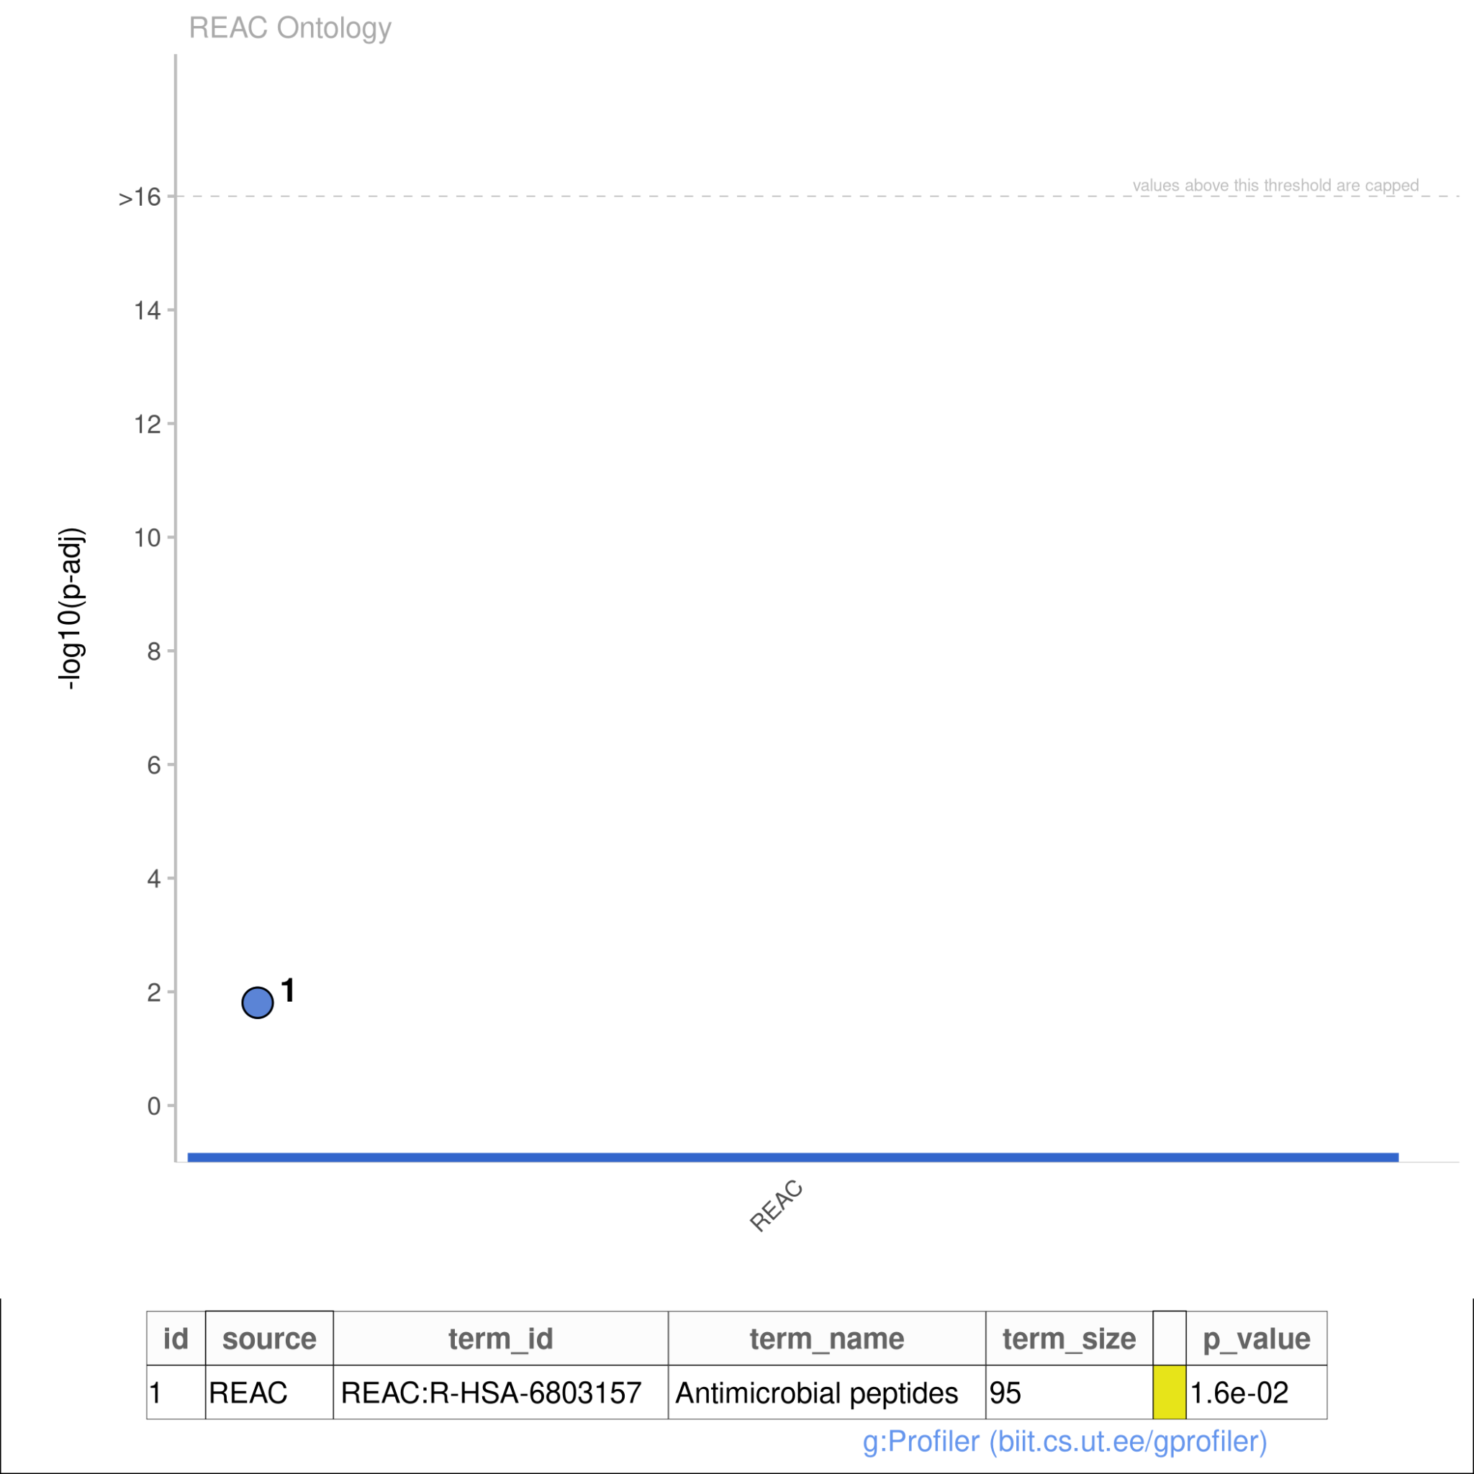
03
DIFFERENTIAL EXPRESSION
Enrichment Analysis
- GO:BP (biological processes)
- GO:CC (cellular component)
- REAC (reactome)
GO:BP Results do seem to corroborate previous studies and support the hypothesis

Slide 9
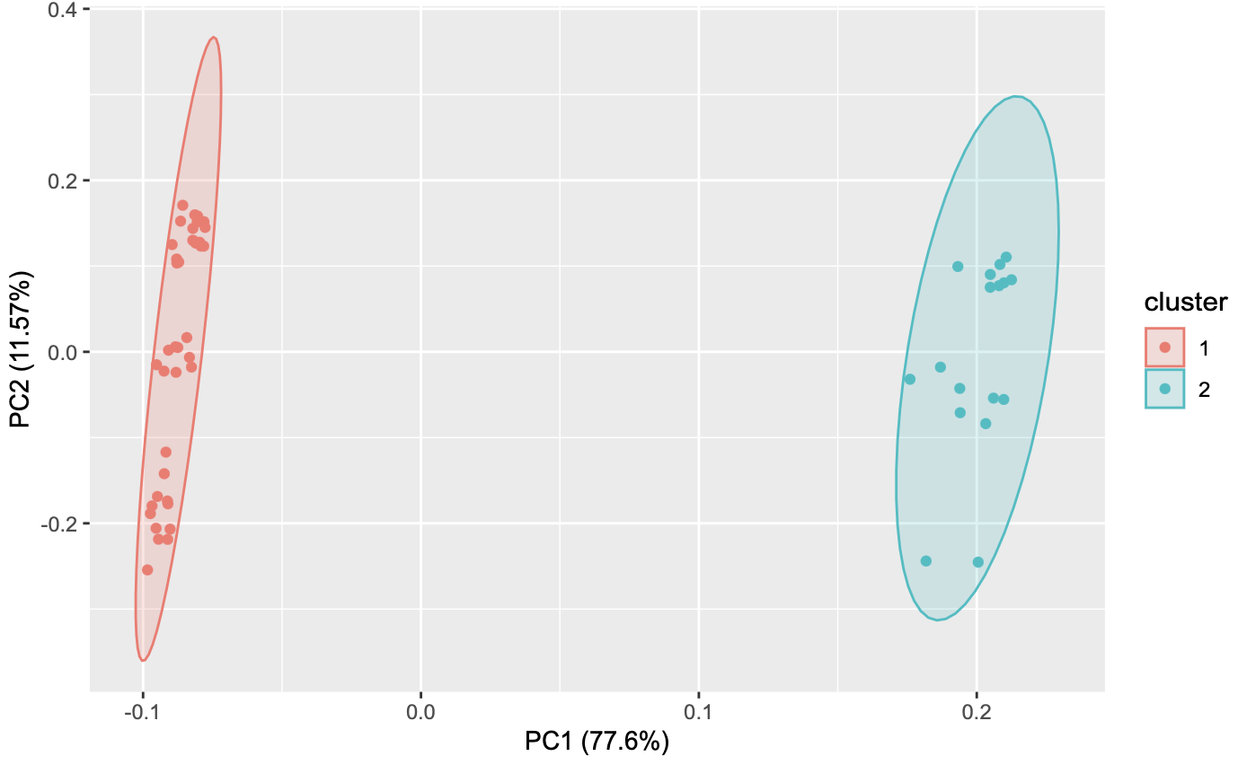
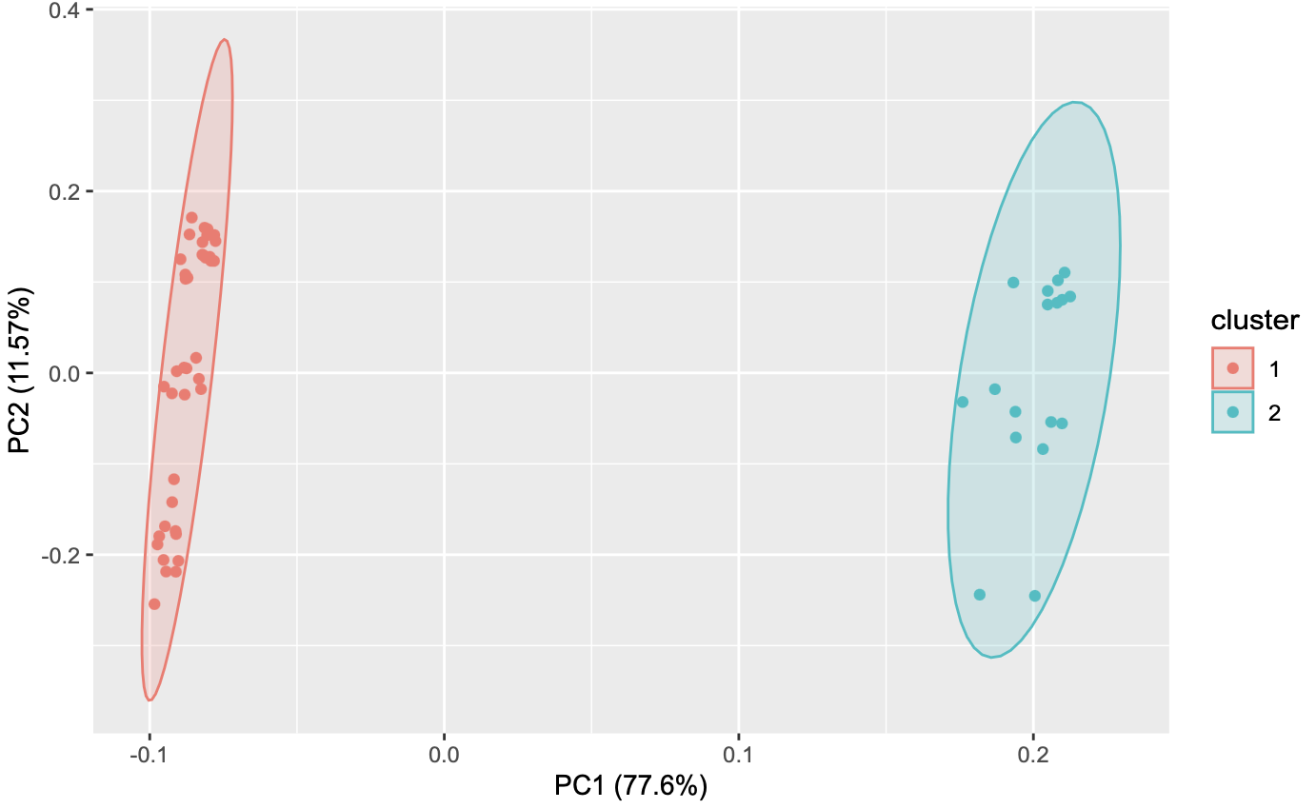
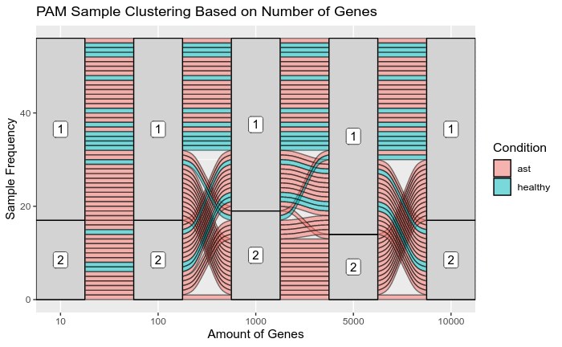
04
CLUSTERING
10 genes vs. 10000 genes
PAM-K (k = 2)
- Clustering shapes changed noticeably
- 10 genes vs 10000 genes appear identical…
- Sankey Maps groupings look very similar…
- Not clustering by condition

Slide 10
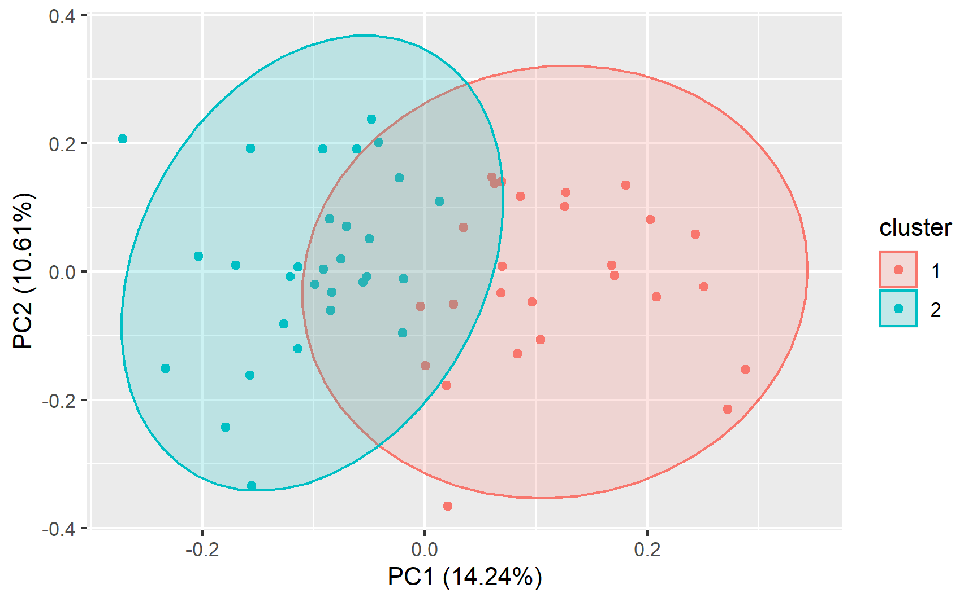
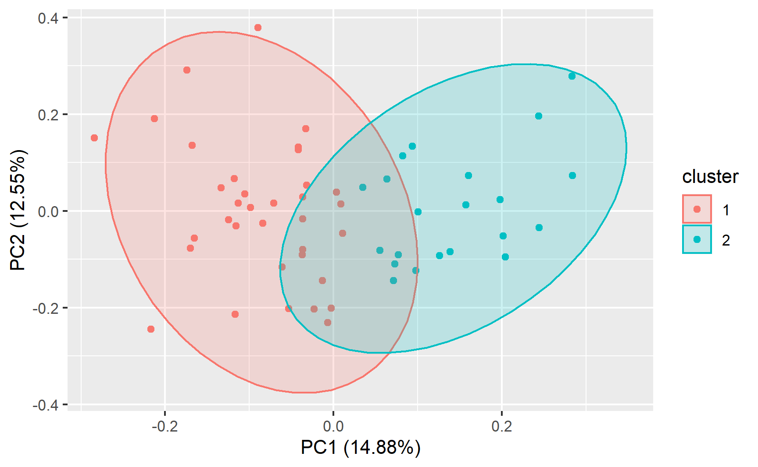
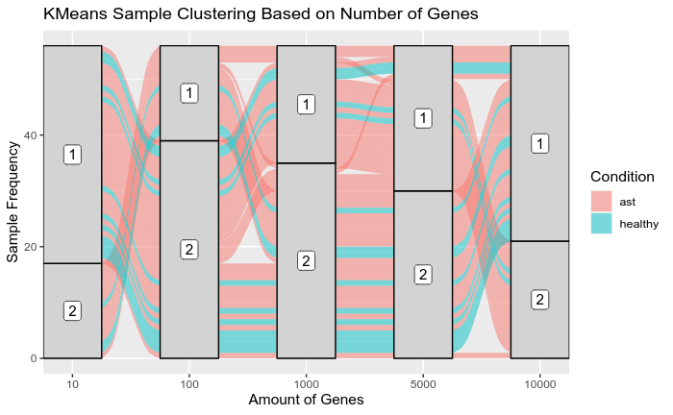
04
CLUSTERING
5000 genes vs. 10000 genes
K-Means (k = 2)
- Clustering shapes changed noticeably
- As genes added, clusters appear closer together
- Sankey Maps vary greatly, not clustering by condition

Slide 11
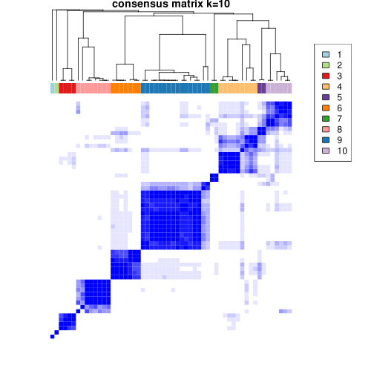
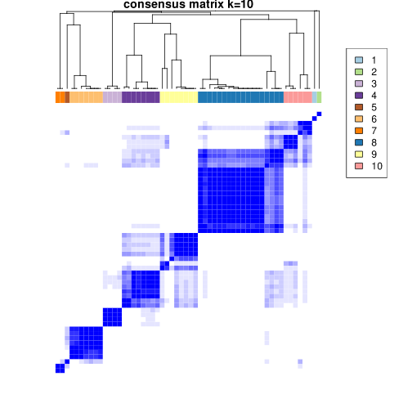
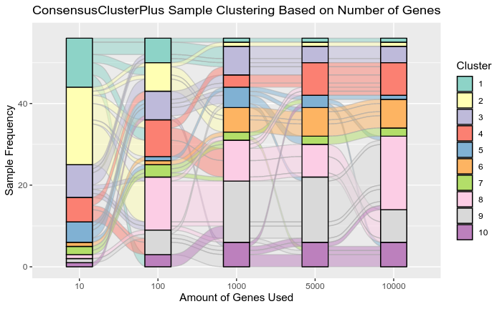
04
5000 genes vs. 10000 genes
CLUSTERING
ConsensusClusteringPlus
- Determined k = 10 to be a good choice
- As genes added, clusters appear closer together
- Sankey Maps vary less as more genes are added
- Probably due to genes
added being less
differentially expressed

Slide 12
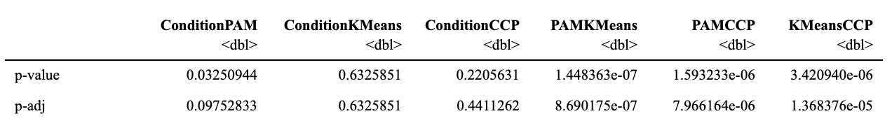
04
CLUSTERING
Statistical Analysis
- None of results dependent compared to condition
- Does not support hypothesis
Should be noted relationship b/w clusters seem to be dependent
- Possible common grouping different from condition…

Slide 13
05
CONCLUSION
What are the differences in gene expression within peripheral blood mononuclear cells between patients with moderate or severe asthma and healthy patients?
Differential Expression and Gene Ontologies:
- Supports hypothesis…just not with any significance
- Gene ontologies support previous studies but no genes were statistically significantly expressed.
Clustering and Statistical Analysis:
- Does not provide support for the hypothesis
- Clustering not by condition
- Statistical tests p-adjs > 0.05

Slide 14
05
CONCLUSION
What Did We Learn & Next Steps?
- If continuing research, we would need to generate additional experimentation on a larger sample of patients.
- Showing some differential expression but a larger sample size would help determine if these genes are statistically significant.
- Further investigate any link between the expression of the immune cells and asthma acquisition in a setting where statistical significance can be supported
- Besides running our analysis again on a larger dataset, one question we have is…what was our clustering analysis clustering our information by if it wasn’t our condition?
- We may also want to identify within our asthmatic group if there is any significant differential expression in genes between the differing severities of asthma.

